Slide 1
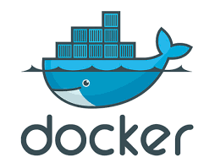
Docker
Velocity training institute
Shantanu Mahajan (sr engg devops)

Slide 2
What is virtualization?
Virtualization is technology that lets you create useful IT services using resources that are traditionally bound to hardware.
It allows you to use a physical machine’s full capacity by distributing its capabilities among many users or environments.
Virtualization is a technique of importing a Guest OS on the top of the host OS.
This technique was a revelation at the at the beginning as it allowed developers to run multiple OS in different VMs on the same physical host.

Slide 3
advantages
Reduced capital and operating costs.
Increased IT productivity, efficiency, agility and responsiveness.
Minimized or eliminated downtime.
Faster provisioning of applications and resources.
Greater business continuity and disaster recovery.
Simplified data center management.

Slide 4
How does virtualization work?
Software called hypervisors separate the physical resources from the virtual environments—the things that need those resources.
Hypervisors can sit on top of an operating system (like on a laptop) or be installed directly onto hardware (like a server), which is how most enterprises virtualize.
Hypervisors take your physical resources and divide them up so that virtual environments can use them.
A hypervisor, also known as a virtual machine monitor or VMM, is software that creates and runs virtual machines (VMs).
A hypervisor allows one host computer to support multiple guest VMs by virtually sharing its resources, such as memory and processing

Slide 5
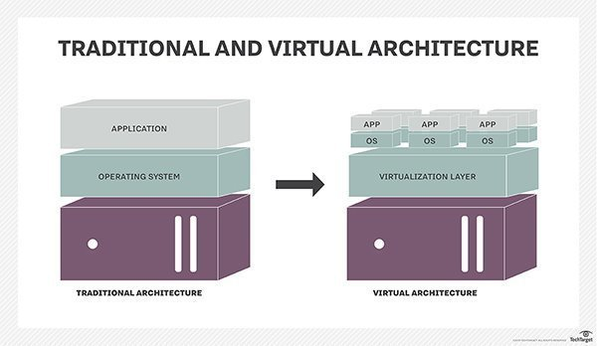

Slide 6
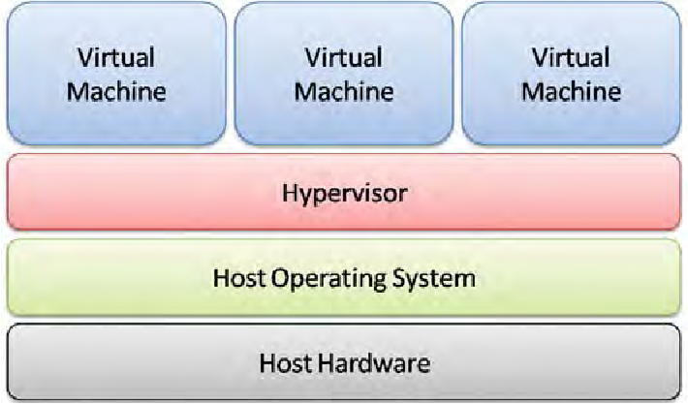
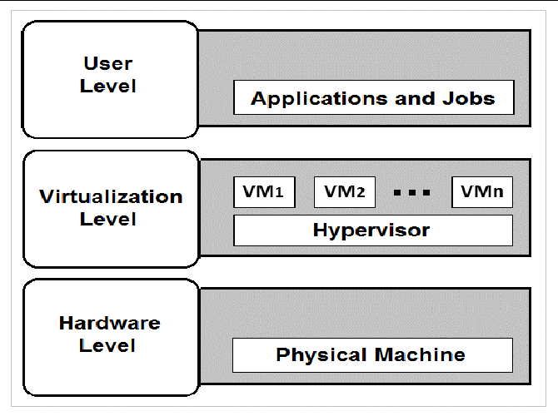

Slide 7
Types of hypervisors
There are two main hypervisor types, referred to as “Type 1” (or “bare metal”) and “Type 2” (or “hosted”).
A type 1 hypervisor acts like a lightweight operating system and runs directly on the host’s hardware, while a type 2 hypervisor runs as a software layer on an operating system, like other computer programs.
The most commonly deployed type of hypervisor is the type 1 or bare-metal hypervisor, where virtualization software is installed directly on the hardware where the operating system is normally installed.

Slide 8
Types of Virtualization
Data virtualization
Desktop virtualization
Server virtualization
Operating system virtualization
Network functions virtualization

Slide 9
Disadvantages of virtualization
Running multiple VMs leads to unstable performance
Hypervisors are not as efficient as the host OS.
Boot up process is long and takes time

Slide 10
Containerization
Containerization is a form of virtualization where applications run in isolated user spaces, called containers, while using the same shared operating system (OS).
A container is essentially a fully packaged and portable computing environment:
Everything an application needs to run—its binaries, libraries, configuration files, and dependencies—is encapsulated and isolated in its container.
The container itself is abstracted away from the host OS, with only limited access to underlying resources—much like a lightweight virtual machine (VM).

Slide 11
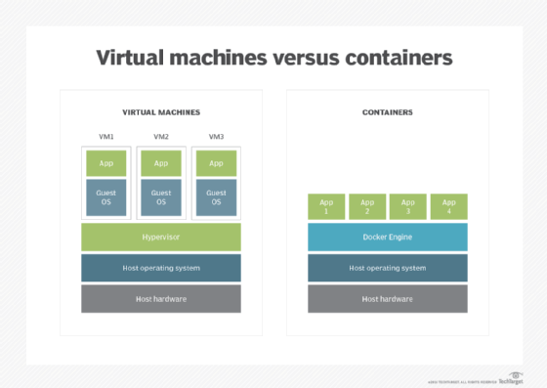

Slide 12
Advantages of containerization
https://hentsu.com/docker-containers-top-7-benefits/

Slide 13
Docker
Docker is an open platform for developing, shipping, and running applications.
Docker enables you to separate your applications from your infrastructure so you can deliver software quickly.
With Docker, you can manage your infrastructure in the same ways you manage your applications.
By taking advantage of Docker’s methodologies for shipping, testing, and deploying code quickly, you can significantly reduce the delay between writing code and running it in production.

Slide 14
The Docker platform
Docker provides the ability to package and run an application in a loosely isolated environment called a container.
The isolation and security allow you to run many containers simultaneously on a given host.
Containers are lightweight and contain everything needed to run the application, so you do not need to rely on what is currently installed on the host.
You can easily share containers while you work, and be sure that everyone you share with gets the same container that works in the same way.

Slide 15
Docker Architecture
Docker uses a client-server architecture.
The Docker client talks to the Docker daemon, which does the heavy lifting of building, running, and distributing your Docker containers.
The Docker client and daemon can run on the same system, or you can connect a Docker client to a remote Docker daemon.
The Docker client and daemon communicate using a REST API, over UNIX sockets or a network interface.
Another Docker client is Docker Compose, that lets you work with applications consisting of a set of containers.

Slide 16
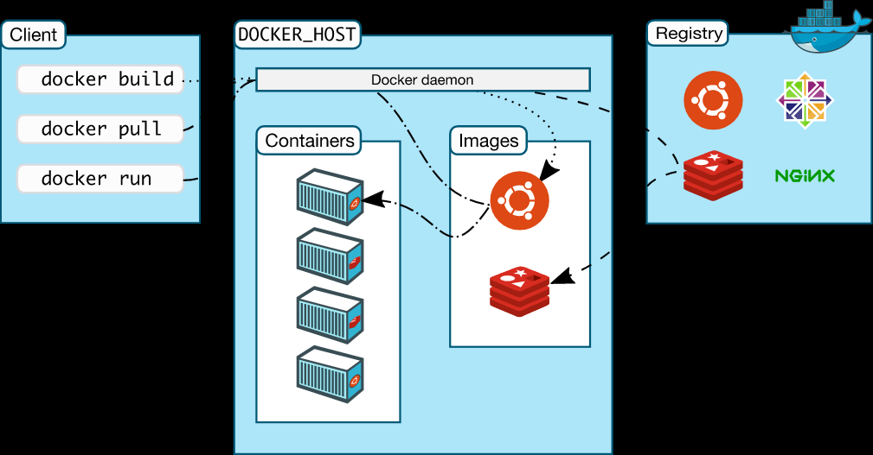

Slide 17
Components
Docker Engine
Docker Engine is an open source containerization technology for building and containerizing your applications. Docker Engine acts as a client-server application with:
A server with a long-running daemon process dockerd.
APIs which specify interfaces that programs can use to talk to and instruct the Docker daemon.
A command line interface (CLI) client docker.

Slide 18
Components
The Docker daemon
The Docker daemon (dockerd) listens for Docker API requests and manages Docker objects such as images, containers, networks, and volumes.
A daemon can also communicate with other daemons to manage Docker services.
The Docker client
The Docker client (docker) is the primary way that many Docker users interact with Docker.
When you use commands such as docker run, the client sends these commands to dockerd, which carries them out.
The docker command uses the Docker API. The Docker client can communicate with more than one daemon.

Slide 19
components
The Docker registries
A Docker registry stores Docker images. Docker Hub is a public registry that anyone can use, and Docker is configured to look for images on Docker Hub by default. You can even run your own private registry.
When you use the docker pull or docker run commands, the required images are pulled from your configured registry.
When you use the docker push command, your image is pushed to your configured registry.

Slide 20
Docker Objects
When you use Docker, you are creating and using images, containers, networks, volumes, plugins, and other objects.
These we will discuss one by one.

Slide 21
objects
1. Images
Images are nothing but a read-only binary template that can build containers.
They also contain metadata that describe the container’s capabilities and needs.
Images are used to store and ship applications.
An image can be used on its own to build a container or customized to add additional elements to extend the current configuration.

Slide 22
Docker image
You might create your own images or you might only use those created by others and published in a registry.
To build your own image, you create a Dockerfile with a simple syntax for defining the steps needed to create the image and run it.
Each instruction in a Dockerfile creates a layer in the image.
When you change the Dockerfile and rebuild the image, only those layers which have changed are rebuilt.
This is part of what makes images so lightweight, small, and fast, when compared to other virtualization technologies.

Slide 23
Docker Containers
A container is a runnable instance of an image.
You can create, start, stop, move, or delete a container using the Docker API or CLI.
You can connect a container to one or more networks, attach storage to it, or even create a new image based on its current state.
By default, a container is relatively well isolated from other containers and its host machine.
You can control how isolated a container’s network, storage, or other underlying subsystems are from other containers or from the host machine.
A container is defined by its image as well as any configuration options you provide to it when you create or start it.
When a container is removed, any changes to its state that are not stored in persistent storage disappear.

Slide 24
Docker Networks
Docker networking is a passage through which all the isolated container communicate. There are mainly five network drivers in docker:
Bridge: It is the default network driver for a container. You use this network when your application is running on standalone containers, i.e. multiple containers communicating with the same docker host.
Host: This driver removes the network isolation between docker containers and docker host. You can use it when you don’t need any network isolation between host and container.
Overlay: This network enables swarm services to communicate with each other. You use it when you want the containers to run on different Docker hosts or when you want to form swarm services by multiple applications.
None: This driver disables all the networking.
macvlan: This driver assigns mac address to containers to make them look like physical devices. It routes the traffic between containers through their mac addresses. You use this network when you want the containers to look like a physical device, for example, while migrating a VM setup.

Slide 25
Docker storage volumes
You can store data within the writable layer of a container but it requires a storage driver. Being non-persistent, it perishes whenever the container is not running. Moreover, it is not easy to transfer this data. With respect to persistent storage, Docker offers four options:
Data Volumes: They provide the ability to create persistent storage, with the ability to rename volumes, list volumes, and also list the container that is associated with the volume. Data Volumes are placed on the host file system, outside the containers copy on write mechanism and are fairly efficient.
Volume Container: It is an alternative approach wherein a dedicated container hosts a volume and to mount that volume to other containers. In this case, the volume container is independent of the application container and therefore you can share it across more than one container.
Directory Mounts: Another option is to mount a host’s local directory into a container. In the previously mentioned cases, the volumes would have to be within the Docker volumes folder, whereas when it comes to Directory Mounts any directory on the Host machine can be used as a source for the volume.
Storage Plugins: Storage Plugins provide the ability to connect to external storage platforms. These plugins map storage from the host to an external source like a storage array or an appliance. You can see a list of storage plugins on Docker’s Plugin page.

